Slide 1



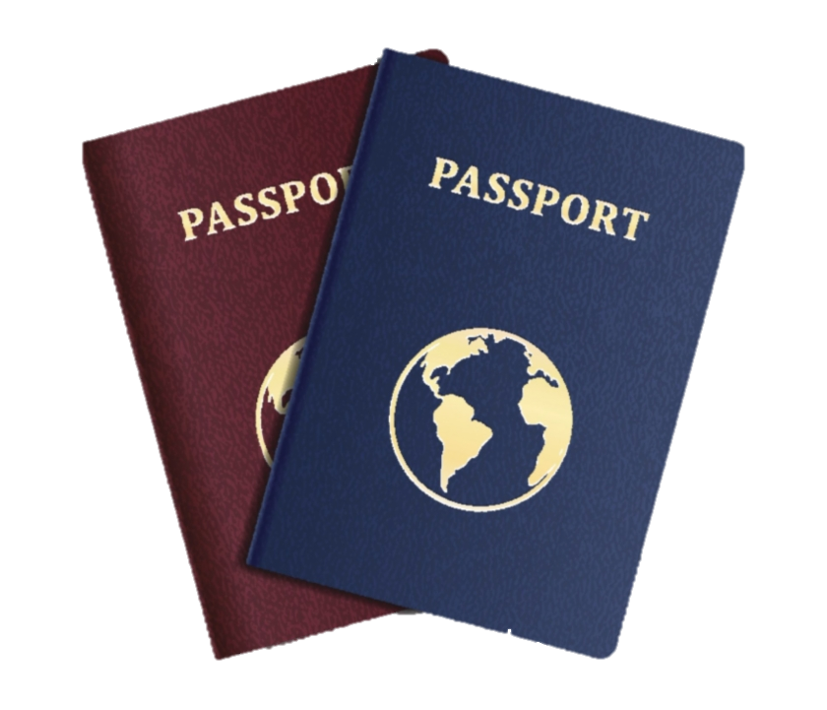

Daniel Halachev, №62547

Slide 2
The Deep and Dark Web
Structure, similarities and differences, statistics

Slide 3
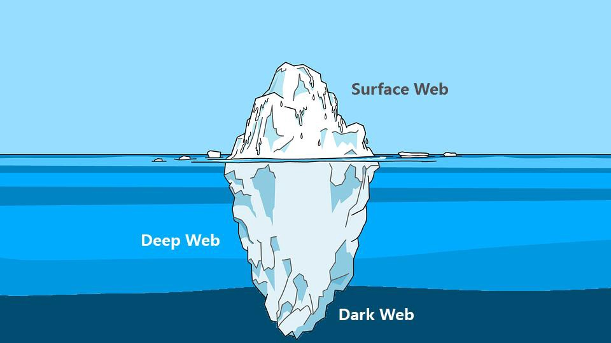
Structure of the Internet
Abstraction of the Internet

Slide 4
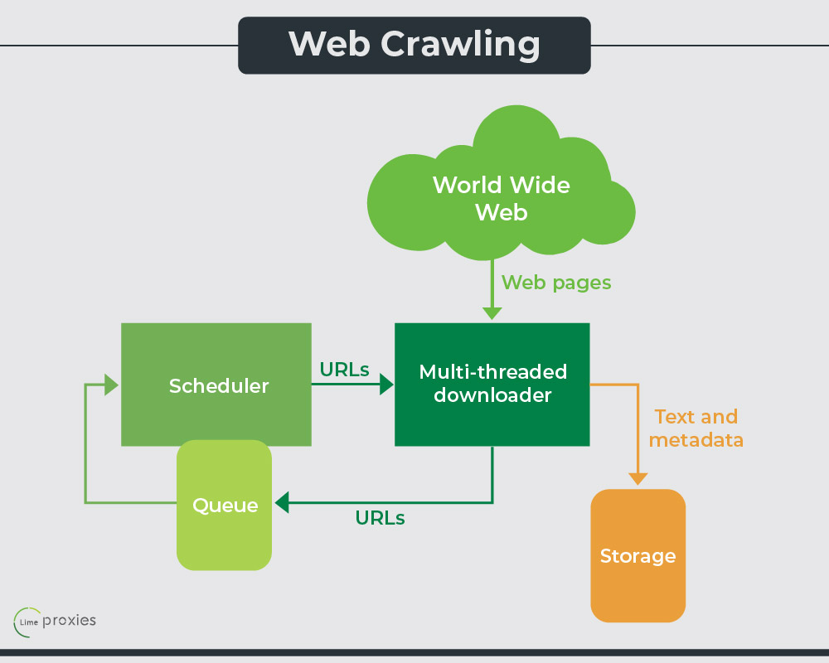



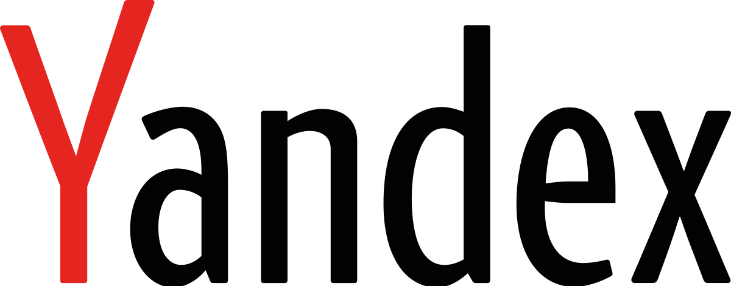
Web Crawlers
How Web Crawling works

Slide 5


Ways to prevent indexing: Dynamic Content
Webpage Server
User requests page
Ask for data
SQL Database
Return webpage
Return requested data
How dynamic content is created

Slide 6
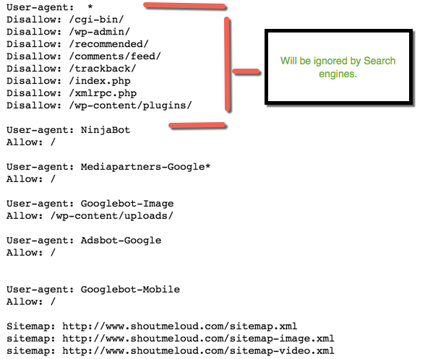
Ways to prevent indexing: robots.txt
https://www.example.com/robots.txt
https://www.a.example.com/robots.txt
A robots.txt code snippet

Slide 7
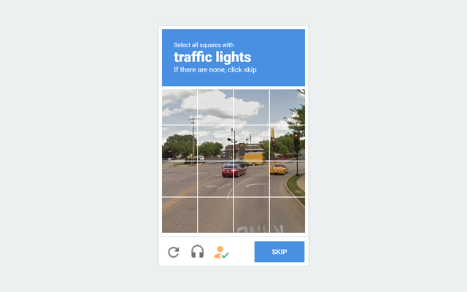

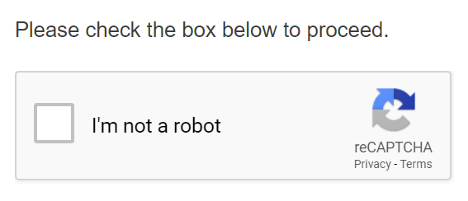
Ways to prevent indexing: Web forms and CAPTCHA
Different examples of CAPTCHA Forms

Slide 8

Ways to prevent indexing: Contextual Web
A typical example of web content, based on IP address

Slide 9
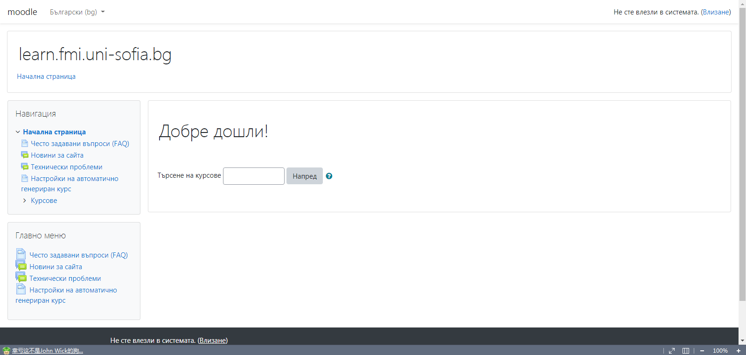
Uses of Non-Surface Web: Design Benefits
Hiding irrelevant information improves the ease of use of websites

Slide 10




Uses of Non-Surface Web: Data protection
Examples of Legal Deep Web Services

Slide 11

Uses of Non-Surface Web: Freedom of speech
Sharing or creating pictures like this one can be dangerous in some countries and societies

Slide 12
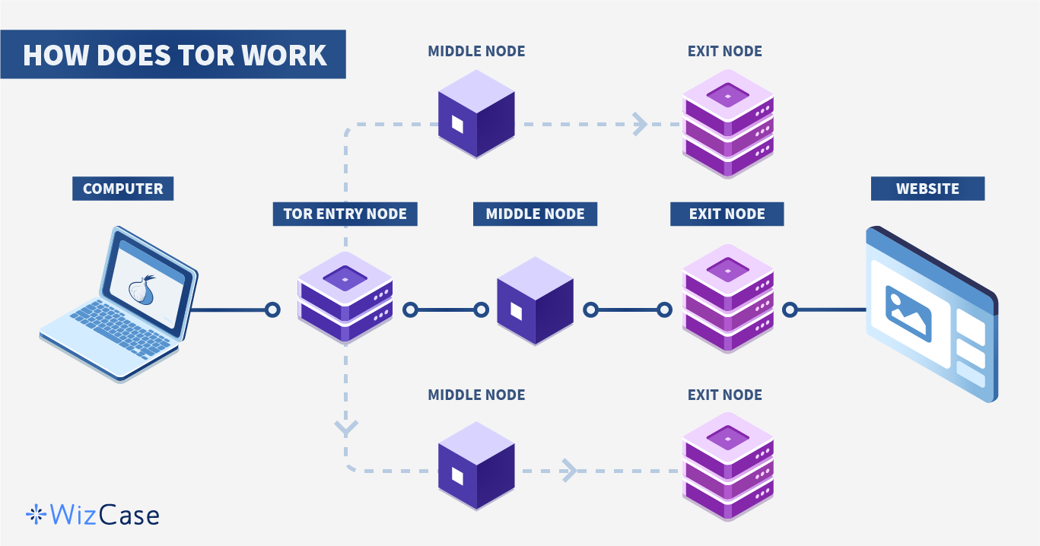
Tor
Tor encrypts the data through volunteer servers knows as “nodes”.

Slide 13
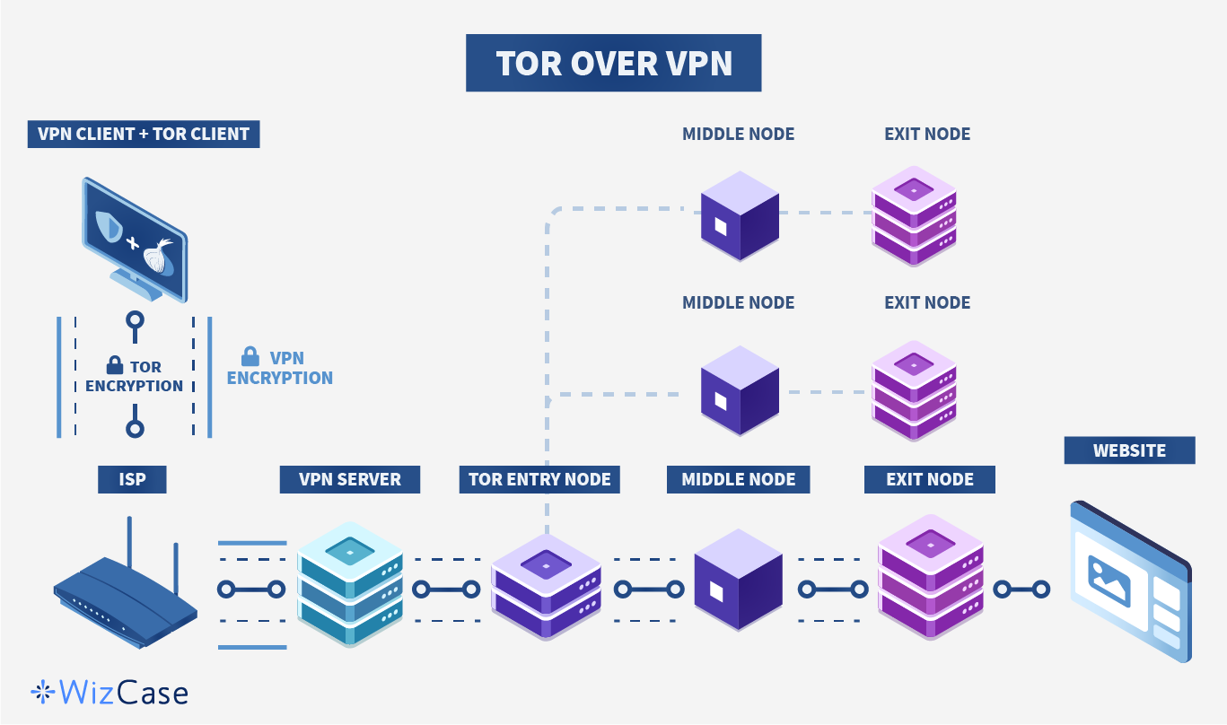
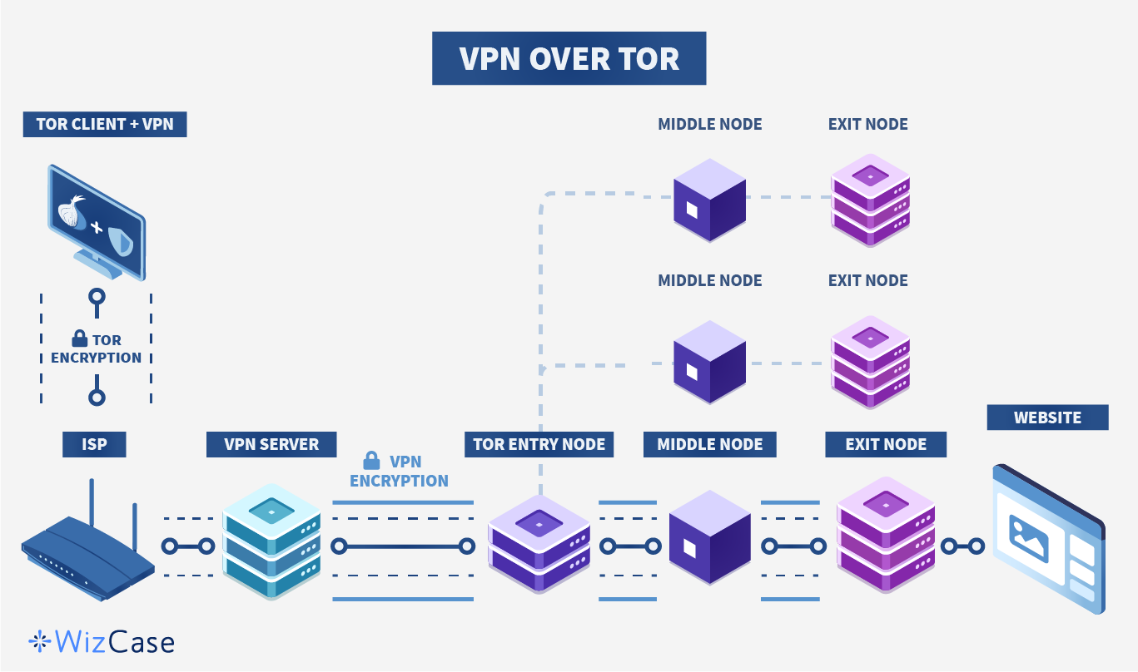
Tor + VPN Setup Types
The recommended method of using Tor and VPN
The alternative approach of using Tor and VPN

Slide 14

Bitcoin
Bitcoin is the preferred method of payment on the Dark Web

Slide 15
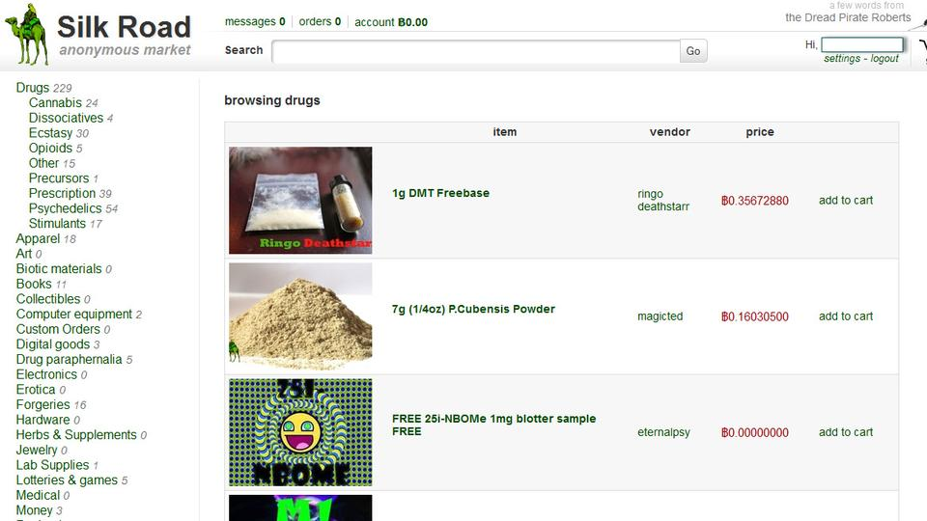

Drug Dealing: The Silk Road
Ross Ulbricht
A screenshot of the Silk Road Drug Dealing Website

Slide 16
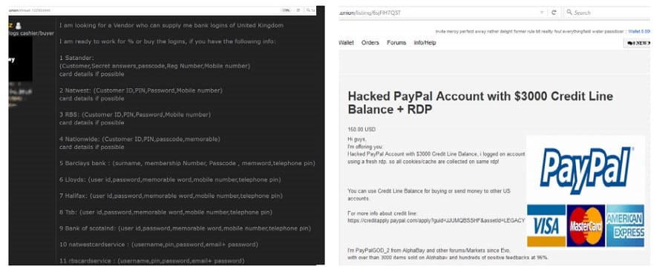
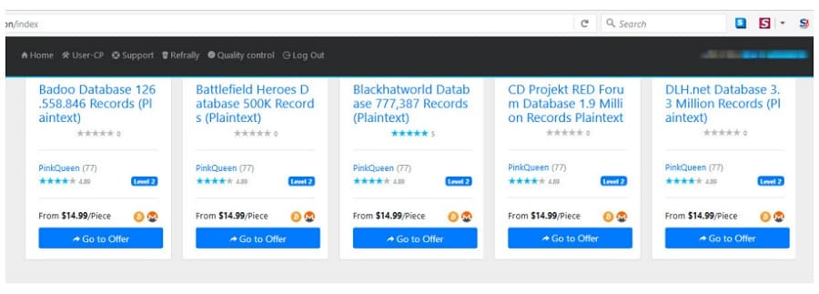
Ad for online bank credentials
PayPal user credentials for sale
Sale of user credentials for various services

Slide 17



Hieu Minh Ngo’s Identity Theft
Ashley Madison
Dating Site Scandal

Slide 18

Hacker services
Hacking services are some of the most demanded on the Dark Web

Slide 19
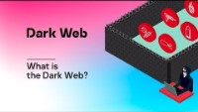

Slide 20
Worldwide usage of Dark Web technologies per country

Slide 21
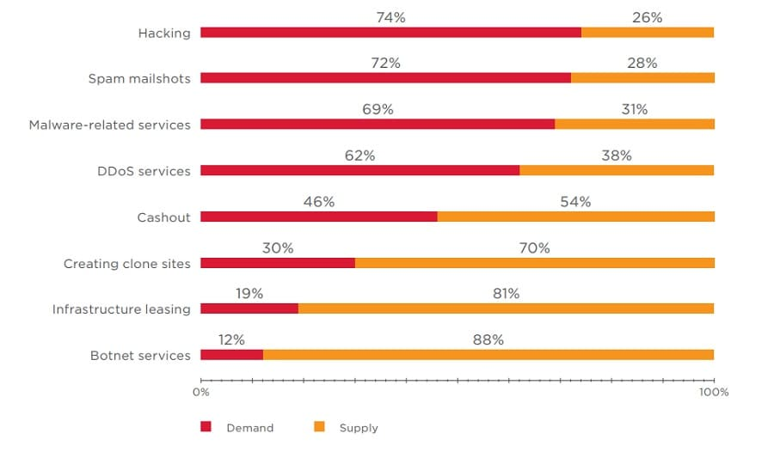
Why Dark Web Markets might never close
Demand and supply of the most common illegal services on the Dark Web Network

Slide 22

So, are Deep and Dark Web a good or a bad thing? Which side is predominant?
Is there a way to prevent illegal activities without affecting legal ones?

Slide 23

The End
No people were harmed in the making of this presentation

